Slide 1
JOMO KENYATTA UNIVERSITY OF AGRICULTURE AND TECHNOLOGY
Solar powered water filtration and purification system
Presented by Charles & Josephine
Supervisor: Mr. Njoroge

Slide 2

Introduction
Access to clean and safe drinking water is a challenge in developing countries.
A reliable and cost effective system is essential to the consumers ensuring good health and sanitation.
2

Slide 3
Objectives
1
2
Main Objective
Specific objectives
To design and implement a solar based water filtration and purification system.
To design and construct a solar powered filtration unit.
To implement an ultra-violet purification system for water disinfection and purification
To develop a prototype for water filtration and purification.
3

Slide 4
Literature Review
Technologies for water purification
Ultrafiltration
Involves forcing water through filter membrane of pore sizes 0.1 - 0.01 um
Removes macromolecules
Ultra-violet purification
Using electromagnetic radiation of wavelength s 100-400 nm.
Sources:
Mercury Lamps
UV Lamps mostly AC based.
UV-C LEDs - cheaper, more efficient and run on available DC supply.
4

Slide 5
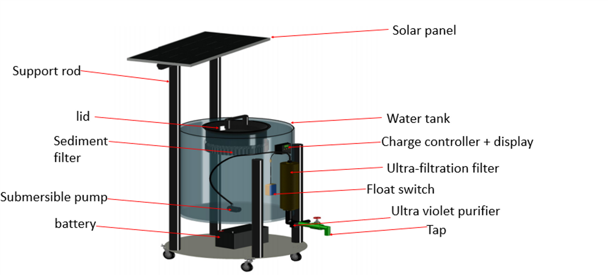
Methodology
1. Conceptualization
3D Design
5

Slide 6
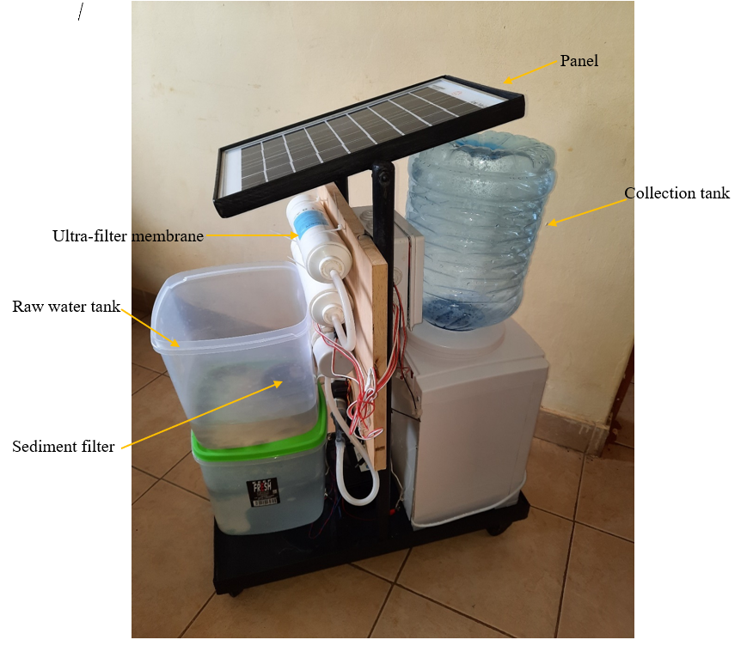
Methodology
2. Hardware Implementation
Steps:
Circuit design and PCB fabrication
Structure and frame
Testing
Assembly
Prototype
6

Slide 7
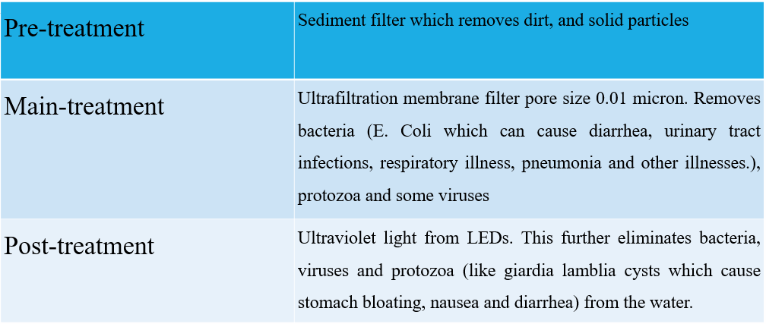
Methodology
3. Treatment Stages
7

Slide 8

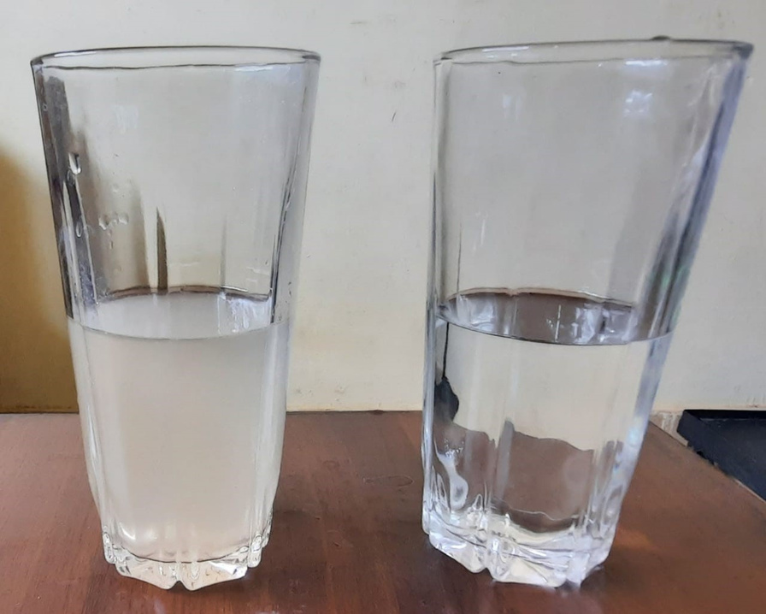
Results
Clean water
Contaminated water was passed through the filtration process and photos taken for comparison
8

Slide 9
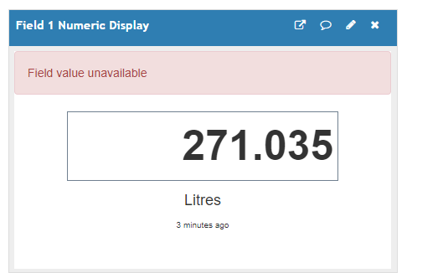
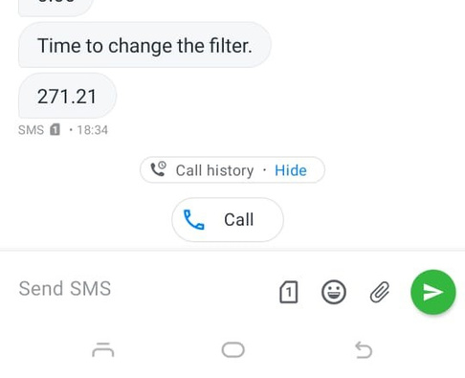
Results
Tristan
Flow statistics
Use of flow meter allowed calculation of total volumes purified
Filter reminders
Based on the flow statistics a reminder can be sent via SMS to the user to inform them on when to replace the filters.
9

Slide 10
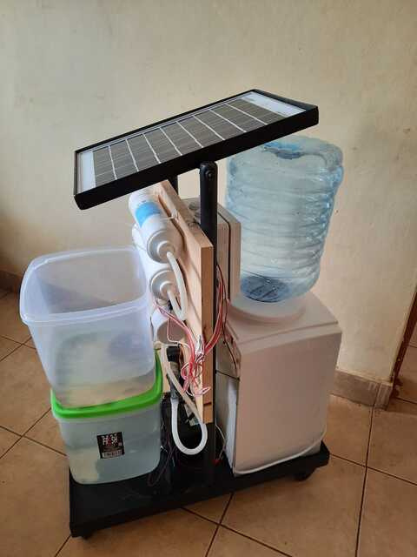
Conclusion
Solar powered filtration and purification system was successfully constructed.
Unit runs on solar through battery and can run for 5 hours.
The unit has inbuilt functionality to inform the user when to replace the ultra-filters after certain filtration amount.
10

Slide 11
Division of Labor
JOSEPHINE TARIYA ENE 212-0073/2016 | CHARLES KARIRA ENE 212-0267/2016
Final report
Literature Review – Ultrafiltration. Microcontroller research and implementation. Chapter 3 | Literature Review – UV Disinfection. Design calculations of UV Chamber. Pump design, flow rates and integration Chapter 4 and 5
Implementation
Fabrication of two raw water tanks with the sediment filter Design of electrical circuit and PCB ThingSpeak integration with microcontroller | Fabrication of the UV-C chamber and piping Hardware implementation of the electrical circuit Microcontroller programming
11

Slide 12
Item | Description | Quantity | Rate | Amount
1 | Ultrafiltration filter | 2 | 833 | 1666
2 | Water tank | 3 | 500 | 1500
3 | 5V Dc pump | 1 | 600 | 600
4 | 12v Submersible Dc pump | 1 | 3000 | 3000
5 | Solar panel | 1 | 3000 | 3000
6 | UV-C LED | 3 | 1200 | 3600
7 | Battery charger | 1 | 1000 | 1000
8 | Battery | 1 | 3000 | 3000
9 | Microcontroller | 1 | 4000 | 4000
10 | Metallic sheets | 1 | 3000 | 3000
11 | Pre-filter | 1 | 1300 | 1300
12 | Relay | 1 | 500 | 500
13 | PCB and etching | 1 | 2000 | 2000
14 | Flow meter | 1 | 800 | 800
15 | Wooden block | 1 | 1000 | 1000
16 | Buck Convertor | 1 | 300 | 300
17 | Water dispenser | 1 | 2000 | 2000
18 | Jumper and wires | 10 | 25 | 250
19 | Miscellaneous |  |  | 3600
TOTAL |  |  |  | 36116
Budget
12

Slide 13

QUESTIONS?
More info visit:
https://bit.ly/3CJgQcQ
THANK YOU

